Slide 1


MEDICAL AI BUSINESS
PRESENTATION
Creating a world where AI is able to empower and improve medical professionals and our healthcare across the globe.

Slide 2
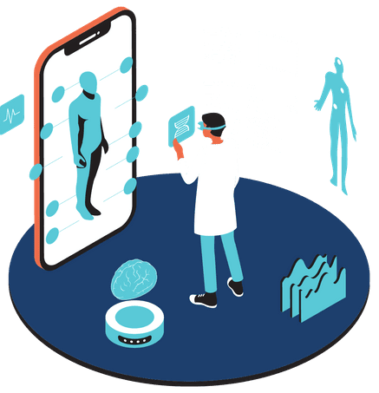
WELCOME TO
OUR COMPANY
We are an AI-driven company that is focused on improving the world of healthcare. Here at Med AI Innovations, our company specializes in creating and finding new potential of AI to increase the safety and effectiveness of medical practices and surgeries.
Our focus is to provide two products that are dedicated to advancing the medicine field, which is an AI diagnosis assistant, and an AI surgical robot. We believe the next steps to revolutionizing the healthcare system is by creating tools that can improve surgical precision, treatment, recovery, and diagnosis.

Slide 3



COMPANY COMMUNICATION FORMS
TRELLO
SLACK
ZOOM
This will be used to organize tasks and projects, track progress, and ensure proper project management.
Provides everyone with real-time communication and organized channels and other collaboration features.
This allows us to hold virtual meetings, therefore facilitating communication between teams and businesses.

Slide 4
COMPANY STAKEHOLDERS
Healthcare Workers
Patients
Investors
Community
Partners
Employees
Suppliers
Researchers

Slide 5

A PESTLE ANALYSIS OF
OUR COMPANY
Political Factors:
Adhering to the healthcare laws and regulations
Maintaining government contracts
Economic Factors:
External economic conditions
Financial impact of developing AI technology
Social Factors:
Addressing public perception of AI
Mitigating negative views of AI with marketing
Implementing nationwide campaigns/classes to increase understanding of AI

Slide 6

A PESTLE ANALYSIS
CONTINUED
Technological Factors:
Continuous researching of AI advancements
Implementing data security measures
Adapting to evolving AI technologies
Legal Factors:
Adhering to health care laws (e.g., HIPAA, GDPR) requires strong data protection.
Collaboration with legal experts is essential for future AI-related legal challenges and legislation.
Environmental Factors:
Sustainable practices, like responsible waste disposal, reduce environmental impact.
Promoting remote work aligns with global environmental agreements.

Slide 7
ABOUT
OUR VALUES
Strive to be continuously innovative
Patient always comes first
Being ethical in our decisions
Adaptable & Transparent
Employee well-being is at utmost importance
Having a diverse staff with no inclusivity

Slide 8


ABOUT
OUR MISSION
Our company is dedicated to improving healthcare with our cutting-edge AI medical technology. We prioritize innovation, ethics, diversity, and customer satisfaction.
We are committed to the well-being of staff and patients, supporting a positive environment. We promise to adhere to all medical regulations as we aim for safety and efficiency.

Slide 9




ABOUT
OUR EXECUTIVE ROLES
Chief Executive Officer:
Overall company vision, strategy, and decision-making.
Chief Technology Officer:
Ensures alignment with company goals.
Chief Medical Officer:
Ensures clinical standards, and liaises with healthcare providers.
Chief Data Officer:
Manages data, oversees data analytics.

Slide 10
ABOUT (CONTINUED)
OUR EXECUTIVE ROLES
Chief Ethics Officer:
Upholds ethical standards in AI development, mitigates bias, and addresses ethical dilemmas.
Chief Compliance Officer:
Ensures the company complies with AI-related laws and regulations.
Chief Marketing Officer:
Develops marketing strategies to reach target audiences and monitors market trends.

Slide 11

ABOUT
OUR MANAGEMENT ROLES
Project Manager:
Oversees the projects of AI, and enforces timelines.
Product Manager:
Manages AI products.
Human Resources Manager:
Handles training, recruiting, and good work environment.
Operations Manager:
Manages day to day operations and ensures efficiency.
Data Security Manager:
Manages the privacy of users data and protects it.

Slide 12
ABOUT
OUR MANAGEMENT ROLES II
Customer Support Manager:
Manages customer support, and address concerns and feedback
Finance Manager:
Oversees the financial operations and ensures financial stability.
Legal and Compliance Manager:
Handles all legal contracts and documents that involve the law.
Development/Training Manager:
Is the head manager of training programs and professional development.

Slide 13




ABOUT
OUR OPERATIONAL ROLES
Administrative Coordinator: In charge of scheduling, and keeping records.
Facilities Manager: Monitors the facilities to make sure they are safe, functioning, and clean.
IT Specialist: Provides support only for the actual employees with their work-related technologies.
Supply Chain Coordinator: Goes through all of the basic supply chain processes and ensure that there is always a steady flow of resources to continue the company's production.

Slide 14
ABOUT
Transportation Coordinator: Handles all transportation requirements for delivering and receiving equipment.
Receptionist: Manages the front desk, welcomes people, and help them get situated and pointed in the right direction for whatever they need help with.
Inventory Specialist: Manages the company's inventory and keeps track of what supplies are available and where.
Documentation Specialist: Manages all documentation/records and would make sure it all compiles with any standards.
OUR OPERATIONAL ROLES II
Training Coordinator: Designs and teaches any training courses that would be needed at our company to make sure everyone stays safe and does their job effectively.
Finance Team: Manages the finances for the company.
Health Officer: Go around frequently to do checks to make sure the facilities are within all health and safety regulations.
Event Coordinator: Plans all events for the company including meetings, charities, workshops, etc.

Slide 15


ABOUT
OUR IT SYSTEMS
Assessment:
AI Development Frameworks
Medical Imaging Software
Surgical Navigation System
Cloud Computing Services
Electronic Health Records
Simulation Software
UI/UX Tools
Data Security:
Our data security protections and protocols ensure that all sensitive users medical information will be protected through tough encryption and a limited number of staff that can access it. Things like employee training, incident response actions, and continuous improvements to code and security measures will help ensure that our company has a safeguard for users medical data.

Slide 16
ABOUT
OUR IT SETUP
AI DIAGNOSIS ASSISTANT
AI SURGICAL ROBOT
AI ENVIRONMENT SETUP
$530,000
$800,000
$100,000
Prices listed are what we sell individual products at to medical facilities and hospitals. It also includes the price to set up our company's environment. Long-Term contracts will result in reduced rate depending on contract duration and number of machines bought.

Slide 17
ABOUT
OUR MARKET ANALYSIS
Two main market focuses
Two main focus populations
Healthcare Providers: These include all departments from hospitals, clinics, and private practices. In these departments, healthcare providers are considered to be surgeons, radiologists, and general practitioners.
Patients seeking advanced care: People who have complex medical conditions that require precise diagnosis and treatment.
Medical Research Institutions: Institutions that are deeply involved in medical research, where AI can aid in data analysis and pattern recognition.
01
02
Healthcare Technology Firms: Companies in the healthcare technology sector can explore ways to integrate AI into their product lines.

Slide 18




OUR RISKS
DATA BREACHES
MISUSE OF AI
TECHNICAL FAIL
ETHICAL ISSUES
Any type of unauthorized access to patient information.
Misuse of AI-driven diagnostics or actions completed by a staff member.
Possible technical glitches or failures that could occur during a surgery or operation.
Ethical concerns that could relate to AI bias and its transparency.

Slide 19
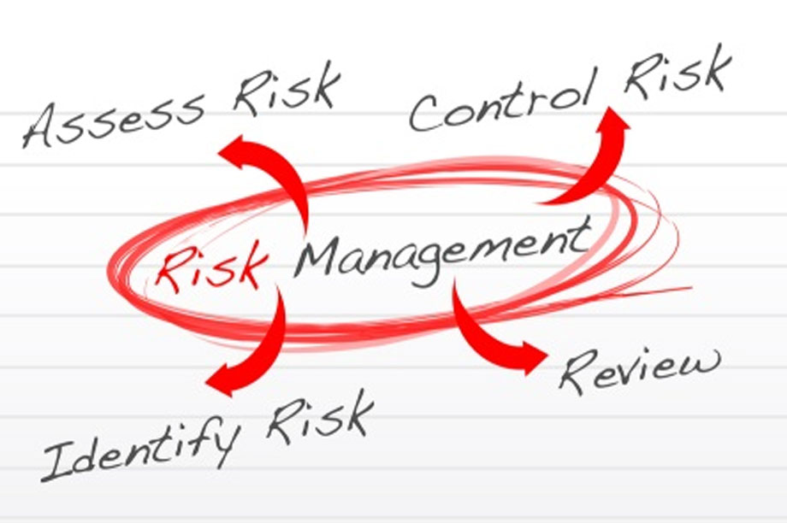
ABOUT
OUR RISK PREVENTION
Risks will be prioritized based on their potential effects on patient safety, data security, and the company's reputation.
To minimize the risk of data breaches and unauthorized access, we will implement advanced cybersecurity protocols in full compliance with AI-related laws and regulations.
Ongoing training programs for healthcare professionals will emphasize ethical considerations when using AI tools.
Rigorous testing and quality control procedures for AI algorithms will be conducted in real-world clinical settings.

Slide 20
ABOUT
ETHICAL STANDARDS
Company Policy
Ethical Standards: Upholding ethical standards is a fundamental principle in our AI development endeavors within the medical sector. This involves a firm commitment to avoiding biases as well. By adhering to these ethical standards, we can prevent potential health disparities and ensure fairness in the implementation of AI technologies.
Establishing a robust ethical framework for AI development in the medical field is highly important. This policy places a strong emphasis on the creation of unbiased algorithms and transparent decision-making processes.
01
Additionally, we prioritize involving diverse stakeholders throughout the development process to guarantee that a wide range of perspectives and unique needs are taken into account comprehensively.
02

Slide 21
ABOUT
LEGAL REVIEW
AI-Specific Laws
Ensuring compliance with healthcare-related laws and regulations, such as the Health Insurance Portability and Accountability Act (HIPAA) in the United States, the General Data Protection Regulation (GDPR) in Europe, and regional data protection laws, is vital.
These regulations are in place to safeguard patient data, especially sensitive health records, by upholding confidentiality and security.
It’s important to note that there are currently no AI-specific laws pertaining to the medical field.
01
While several countries and organizations have proposed regulations addressing the use of AI in healthcare, none of these regulations have been formally adopted.
02

Slide 22
ABOUT
COMPANY POLICY
Compliance on Standards
Our organization is firmly committed to establishing a robust ethical framework for AI development in the medical domain. This commitment includes a strong emphasis on the development of unbiased algorithms and transparent decision-making processes.
Furthermore, we actively involve diverse stakeholders throughout the development process to ensure that comprehensive perspectives and unique needs are carefully considered at every stage.
Our organization places a high value on accountability and oversight in AI development.
01
02
We have established clear mechanisms for monitoring our AI systems and regularly conduct internal audits to ensure compliance with our ethical framework and company policies.

Slide 23

WE PROVIDE
A NEW FUTURE
Our company is dedicated to developing advanced AI technology for improved medical treatments, while prioritizing customer safety. We are committed to ethical and transparent AI practices. Creating a supportive work environment, promoting diversity, and fostering partnerships in healthcare are additional key objectives, along with strategic marketing to stay competitive.
We plan on establishing these objectives through these strategies, such as, Research and Development which
prioritizes ongoing research and development to advance AI technology. Safety and Ethical Practices, which implement and enforce robust safety protocols and ethical guidelines for AI usage. Strategic Partnerships and Effective Marketing which help develop strategic partnerships in the healthcare industry to expand our reach and influence.

Slide 24
THANKS FOR WATCHING
Med AI Innovations

